Slide 1


Colorado Crash Data – Analysis and Modeling
November 2023

Slide 2
Analyzing and Modeling Colorado Crash Data with Machine Learning
Sai Srikar Emani - saisrikar.emani@ucdenver.edu
Saurav Avinash Changde - sauravavinash.changde@ucdenver.edu
Kurt Cushman - kurt.cushman@ucdenver.edu
Harshitha Sai Addepalli - harshithasai.addepalli@ucdenver.edu
University of Colorado Denver – Department of Computer Science
Denver, United States of America
Project Presentation Link: https://drive.google.com/drive/folders/1MJM5-agku5SBd-PSExlZdR9rlSzKaOMT?usp=sharing

Slide 3

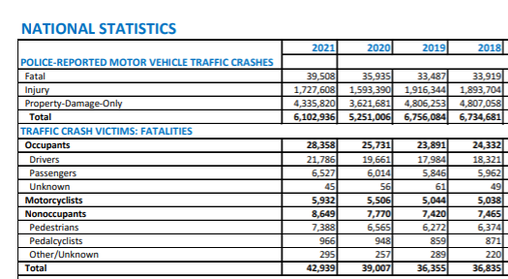
Introduction
Problem Statement
According to statistics from the National Highway Traffic Safety Administration (NHTSA), despite the number of traffic incidents dropping overall in the last two years, there has been an increase in fatalities.
There has been extensive research into crash statistics to attempt to decrease these numbers, yet progress has been minimal. The purpose of this study is to compile all available traffic-related incidents in the state of Colorado dating back to 2007.
The compiled information will be analyzed in an attempt to identify correlations amongst the data points collected for future efforts in crash mitigation.

Slide 4
Related Works
Sun Z et al. (2020) conducted a detailed crash analysis of mountainous freeways, revealing challenges arising from the presence of numerous bridges, tunnels, and interchanges. Their findings underscored the higher incidence of rear-end crashes due to difficulties in managing inter-vehicle interactions in these terrains (1).
The research was conducted in China but has mountains freeways and tunnels are like the freeways and tunnels in Colorado, USA.
The reason we have decided to research this article is the abundance of bridges, tunnels, and interchanges in China's central and western areas.
Russo F et al. (2014) worked out road safety from the perspective of driver gender and age as related to the injury crash frequency and road scenario. The study investigates the correlation between different demographics (gender and age) of drivers and the likelihood of being involved in injury crashes (2).
This study has 8 years of data analyzed.
These studies show that the combination of driver age and gender further refines the contribution of those variables to collisions.

Slide 5
Related Works
Patil S et al. (2012) employed nested logit models to analyze crash severities, particularly focusing on accounting for underreported crashes. Their research highlighted the significance of considering unreported incidents to avoid biased estimations of the effects of explanatory variables (3).
The nominal logit (NL) and multinomial logit (MNL) model specifications are used in the crash injury severity data analysis for various reasons. These specifications are more flexible in terms of capturing the effects of independent variables when compared to the ordered response probit (OP) models.
The authors came to the conclusion that estimations of the effects of the explanatory variables and their elasticities may be markedly skewed if the underreporting is ignored.
Anderson J & Hernandez S (2017) delved into heavy-vehicle crash rate analysis using Tobit regression, identifying contrasting effects of lower speeds on crash rates for heavy versus smaller vehicles (4).
The study isolates the crash data to analyze large vehicles.
The authors used Tobit Regression to analyze vehicle crash-rate.

Slide 6
Related Works
Qu Y et al. (2022) leveraged association rule mining for crash analysis, unveiling intrinsic relationships between contributing factors and accidents, revealing correlations based on road conditions, driver characteristics, and environmental factors (5).
Association rule mining (ARM) has been proposed for crash analysis. Since ARM much outperforms conventional modeling techniques.
With a total of 1080 samples, the summary results provide information on the event severity of baseline, crash, and near-crash occurrences.
Chen MM & Chen MC (2020) compared logistic regression, decision tree, and random forest models for road accident severity prediction, concluding that random forest exhibited superior accuracy in their analysis (6).
The authors say that Logistic Regression is the most popular (6).
According to the study the nonparametric categorization and regression tree (CART) approach has garnered more attention in recent years for its application to transportation-related issues.

Slide 7

Modeling Methods
With the intent to build on related research that leveraged other methodologies, the following machine learning models were employed:
ID3
Random Forest
Naïve Bayes
Logistic Regression

Slide 8
Dataset Details
Years collected: 2007– 2022
Total incidents: 1,627,682
Data points per incident: up to 84
Total points analyzed: 136,725,288
Data sourced from Colorado Department of Transportation(CDOT)
5 V's of Big Data:
Variety – categorical and numerical
Volume & Velocity – huge volumes of data signify the velocity at which data is generated
Veracity & Value – very accurate and reliable for understanding and predicting traffic crashes

Slide 9
RESULTS
Key Findings
Statistical insights revealed significant patterns in
Accident severity – 'public damage only' or 'fatal' or 'non-fatal'
Weather – more accidents caused during clear weather & due to negligence of drivers; next highest is in snow/icy conditions
Time – daylight sees more accidents surprisingly
Comparative model analysis showed varying strengths in predicting accidents.
Notable correlations between weather, road conditions, and accident rates.
Results
Model Performance: ID3 and Random Forest showed high accuracy, with ID3 high-scoring at 99.95% accuracy .
Predictive Insights: Identified critical factors influencing accidents, including road contour and grade, weather, and location.
Practical Applications: Visualizations highlighted accident hotspots and temporal patterns, offering actionable insights for road safety improvements.

Slide 10
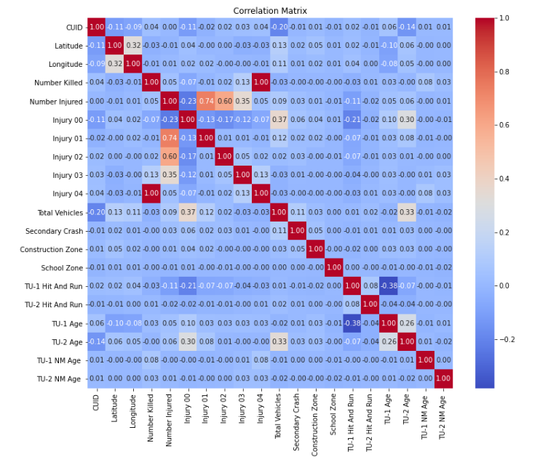
Correlation Map

Slide 11
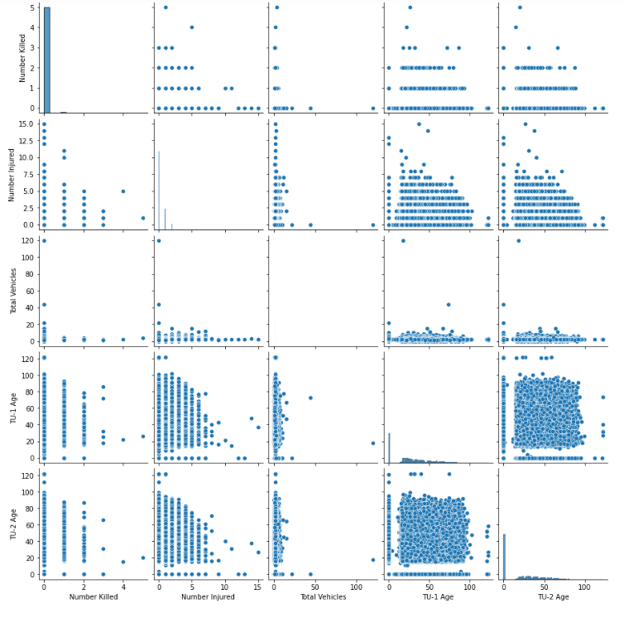
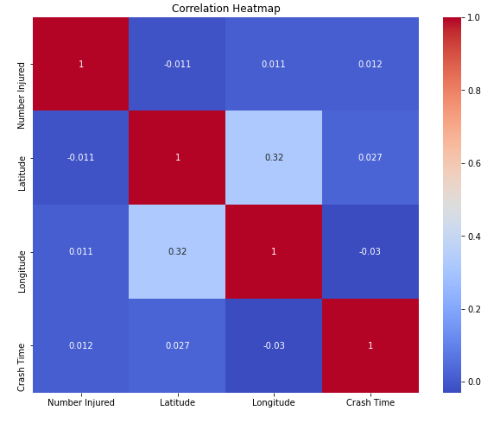
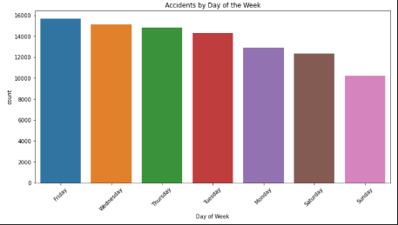
Correlation Maps

Slide 12
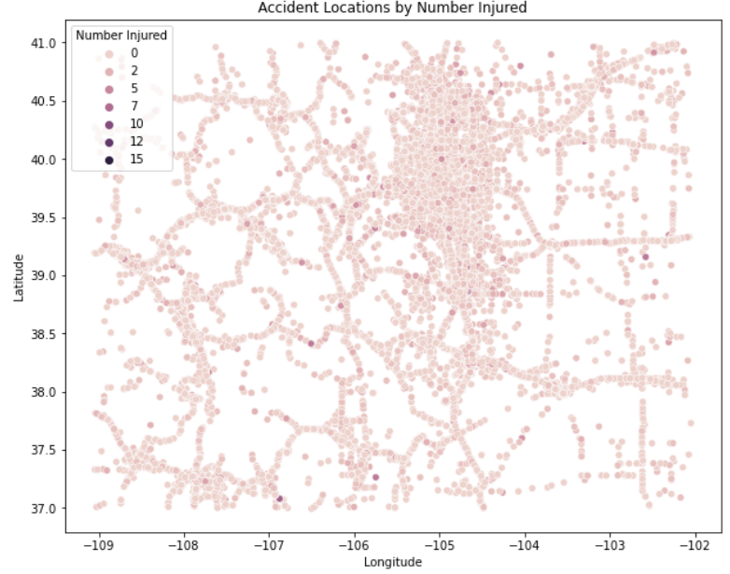
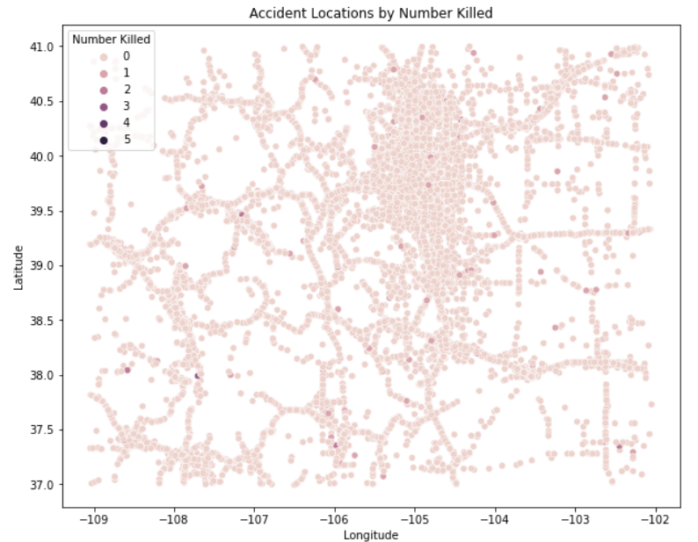
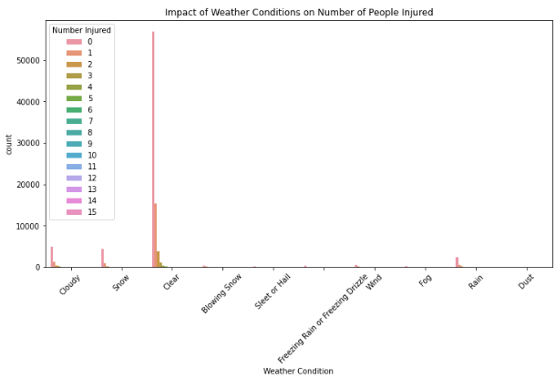
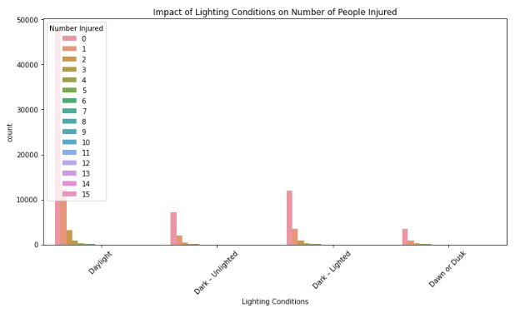
Findings

Slide 14
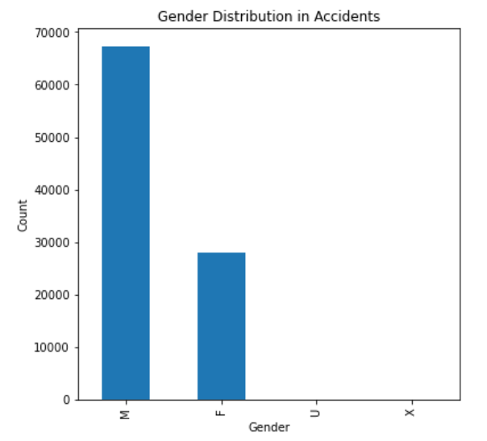
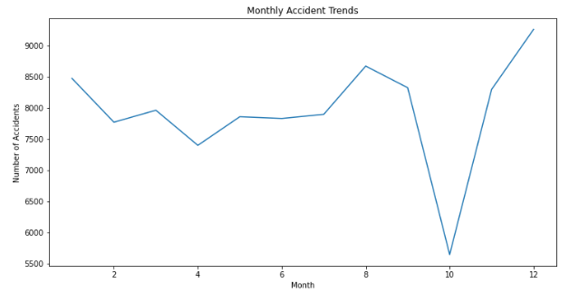
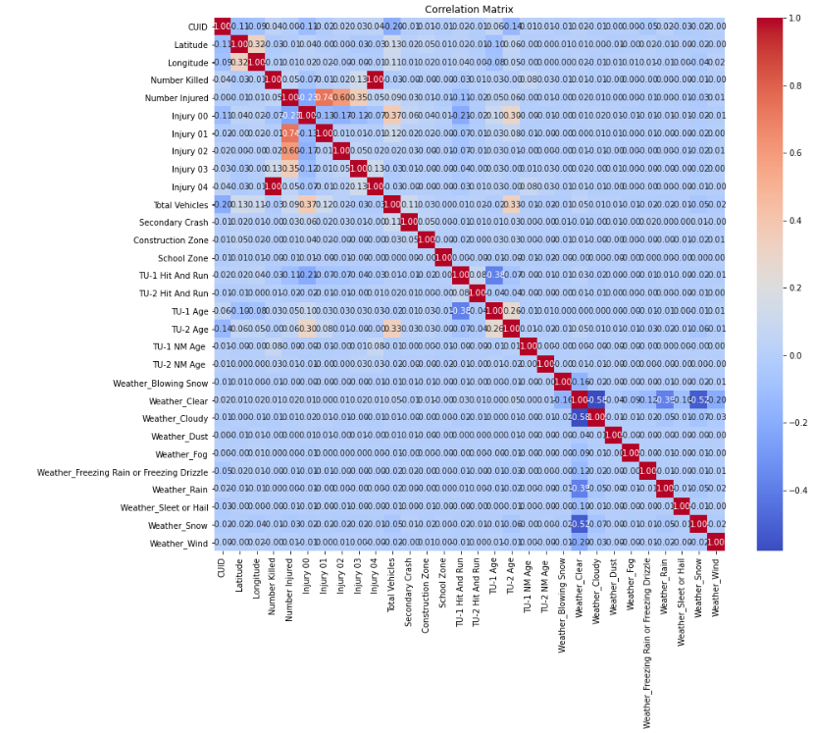
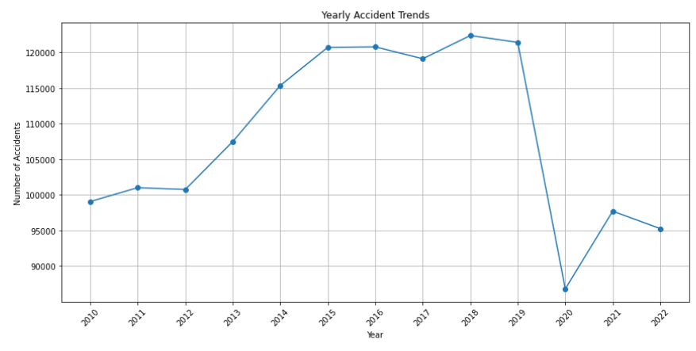
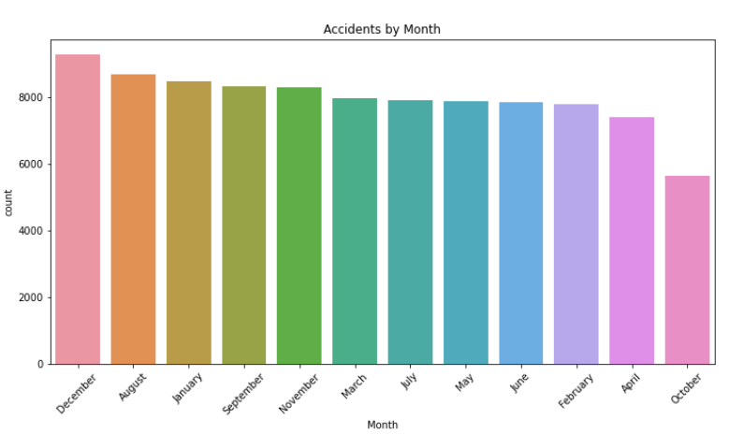
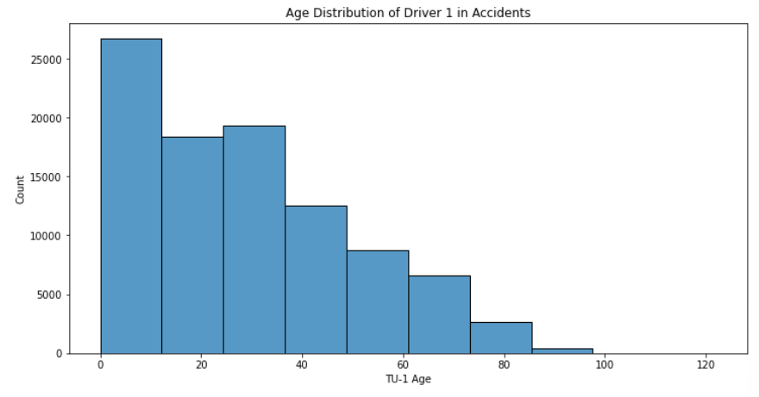
Slide title 7

Slide 15
conclusion
Our extensive investigation of Colorado collision data using machine learning models yielded useful insights into the complicated dynamics of
traffic events. Here are the important findings from our research:
Understanding Traffic Accident patterns: From 2007 to 2022, we investigated traffic accident patterns by taking into account characteristics such as time of day,
road conditions, location, severity, driver impairment, vehicle type, and injuries.
Machine Learning Model Performance: To discover correlations and trends in the dataset, we used four main machine learning models: ID3, Random Forest
(RF), Nave Bayes, Logistic Regression (LR). Each model provided a distinct viewpoint, allowing us to obtain a thorough knowledge of the data.
Geographic Comparison and Scope Expansion: Recognizing the need for a broader viewpoint, we broadened the scope by integrating a big dataset from
Colorado. This geographic diversity allows us to capture regional idiosyncrasies, resulting in a more contextually relevant study.
Motivation from National patterns: Our research was prompted by disturbing patterns observed by the National Highway Traffic Safety Administration
(NHTSA), in which the number of deaths increased despite a drop in overall reported collisions. Our study aims to provide insights that might help
influence solutions for dealing with this alarming trend.
Contextualization of Related Work: The broad examination of related work gave a sophisticated grasp of the field's current literature. Categorizing studies
under approaches such road scenario-based discretization, safety performance functions, and nested logit models assisted in contextualizing our study
within the larger landscape of traffic collision prediction.

Slide 16
Future work
Integration of Real-Time Data: Investigate the integration of real-time data sources to improve the prediction models' timeliness and responsiveness. This might incorporate real-time
weather updates, road conditions, and traffic patterns to increase accident forecast accuracy.
Temporal study and Trend Prediction: Extending the study to incorporate temporal patterns in accident rates, such as daily, weekly, or seasonal fluctuations. Creating models that
can forecast future trends in order to allow preemptive actions and resource allocation.
Regional Specific Spatial Analysis: Conducting a more detailed geographical analysis to identify specific places or road segments that are prone to accidents. Incorporating geospatial data
and sophisticated mapping techniques to identify high-risk regions for targeted safety measures could be part of this.
Driver Behavior Data Inclusion: Data on driver behavior, such as speeding tendencies, lane discipline, and adherence to traffic regulations, could be included. Integrating this
behavioral data might offer a more complete picture of the elements that contribute to accidents.

Slide 17
references
Sun Z, Liu S, Li D, Tang B, Fang S. Crash analysis of mountainous freeways with high bridge and tunnel ratios using road scenario-based discretization. PLoS One. 2020 Aug 10;15(8):e0237408. doi: https://doi.org/10.1371/journal.pone.0237408. PMID: 32776981; PMCID: PMC7416955.
Russo F, Biancardo SA, Dell’Acqua G. Road safety from the perspective of driver gender and age as related to the injury crash frequency and road scenario. Traffic Inj Prev. 2014;15(1):25-33. Doi: https://doi.org/10.1080/15389588.2013.794943. PMID: 24279963.
Sunil Patil, Srinivas Reddy Geedipally, Dominique Lord, Analysis of crash severities using nested logit model—Accounting for the underreporting of crashes, Accident Analysis & Prevention, Volume 45, 2012, Pages 646-653, ISSN 0001-4575, https://doi.org/10.1016/j.aap.2011.09.034.
Anderson, J., & Hernandez, S. (2017). Heavy-Vehicle Crash Rate Analysis: Comparison of Heterogeneity Methods Using Idaho Crash Data. Transportation Research Record, 2637(1), 56-66. https://doi-org.aurarialibrary.idm.oclc.org/10.3141/2637-07
Yansong Qu, Zhenlong Li, Qin Liu, Mengniu Pan, Zihao Zhang, "Crash/Near-Crash Analysis of Naturalistic Driving Data Using Association Rule Mining", Journal of Advanced Transportation, vol. 2022, Article ID 6562649, 19 pages, 2022. https://doi.org/10.1155/2022/6562649
6. Chen M-M, Chen M-C. Modeling Road Accident Severity with Comparisons of Logistic Regression, Decision Tree and Random Forest. Information. 2020; 11(5):270. https://doi.org/10.3390/info11050270
7. Huang, H., Abdel-Aty, M. A., & Darwiche, A. L. (2010). County-Level Crash Risk Analysis in Florida: Bayesian Spatial Modeling. Transportation Research Record, 2148(1), 27-37. https://doi-org.aurarialibrary.idm.oclc.org/10.3141/2148-04
8. Predicting Future Driving Risk of Crash-Involved Drivers Based on a Systematic Machine Learning Framework. https://www.mdpi.com/1660-4601/16/3/334
9. Tanmoy Bhowmik, Shamsunnahar Yasmin, Naveen Eluru, A New Econometric Approach for Modeling Several Count Variables: A Case Study of Crash Frequency Analysis by Crash Type and Severity, Transportation Research Part B: Methodological, Volume 153, 2021, Pages 172-203, ISSN 0191-2615, https://doi.org/10.1016/j.trb.2021.09.008 10. Table of national crash statistic (https://cdan.dot.gov/tsftables/National%20Statistics.pdf).

Slide 18
THANK YOU

